Slide 1
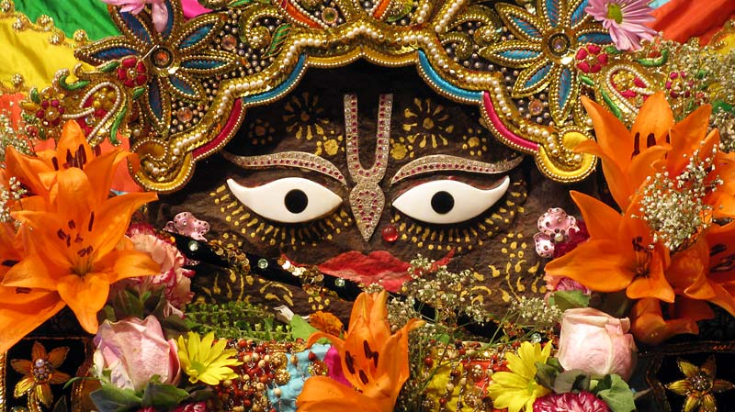
Glories of Govardhan (गोवर्धन)

Slide 2
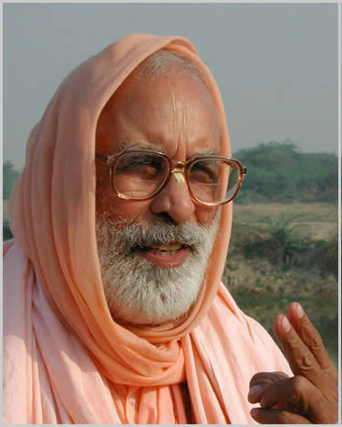
Prayers to Srila Gurudeva
Om Anjana Timirandhasya
Jnanajana Salakhaya
Chakshurunmilitam-yena
Tasmai Shri Guruve Namaha

Slide 3
Who is Govardhan?

Slide 4
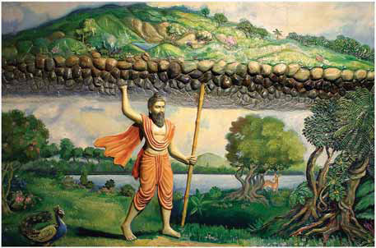
King of mountains

Slide 5
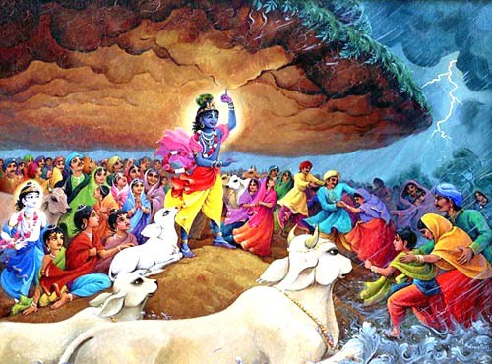
Krishna lifted Govardhan and held for 7 days 7 nights

Slide 6
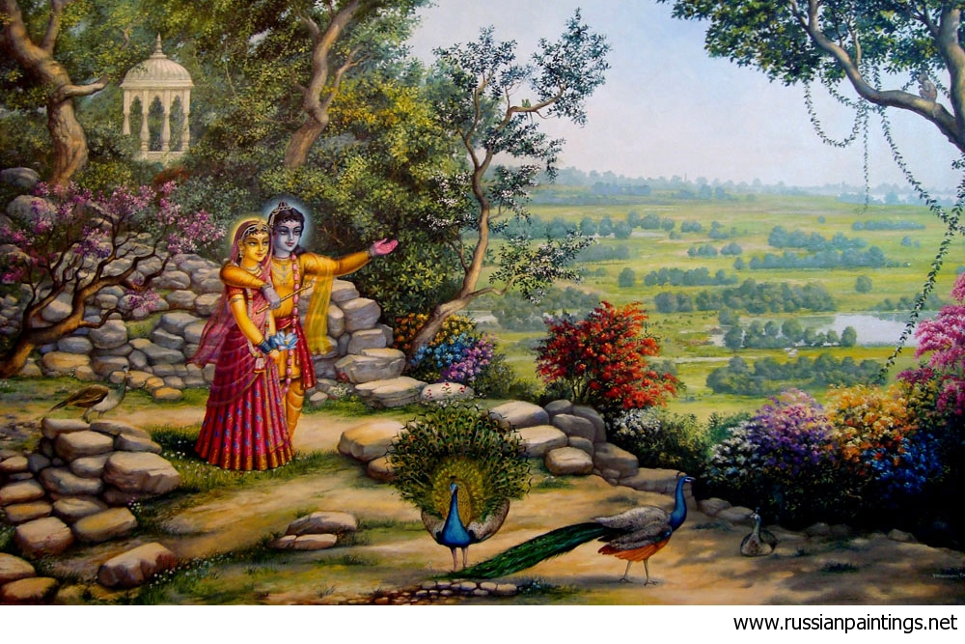
Krishna performed many sweet leelas (viz. collecting toll)
Surrounded by beautiful lakes and kunjas

Slide 7
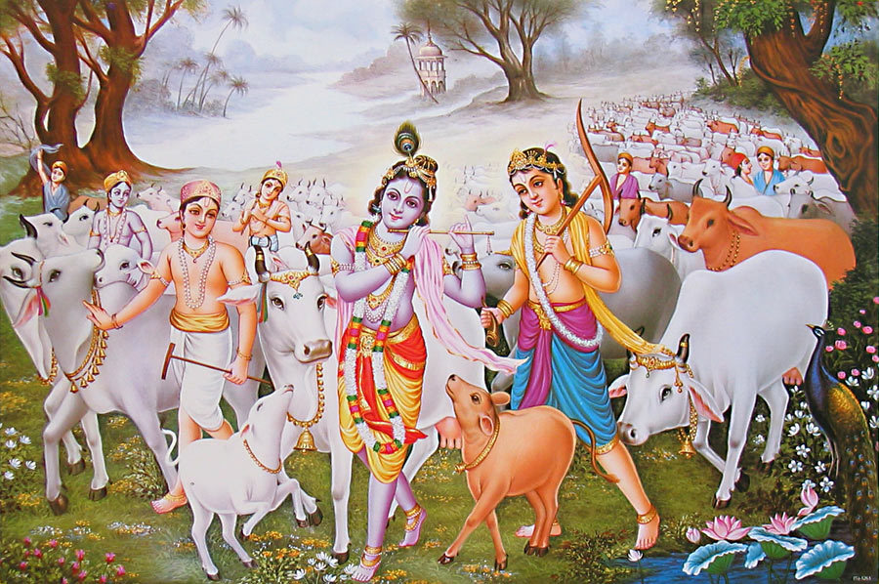
Everyday Krishna used to take cows for herding to Govardhan

Slide 8
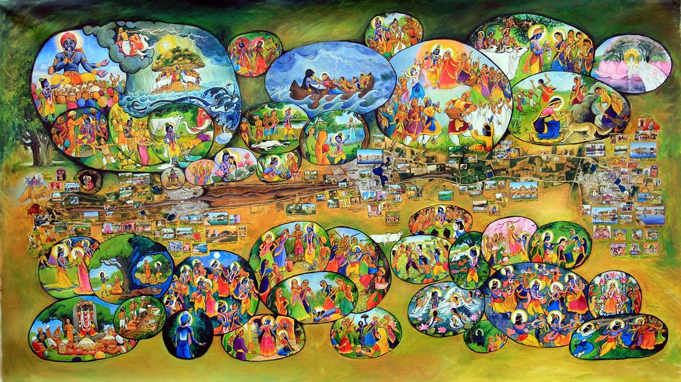
Without taking shelter to the lotus feet of Govardhan, getting Prema Bhakti for Krishna is not possible.

Slide 9
Govardhan Parikrama

Slide 10
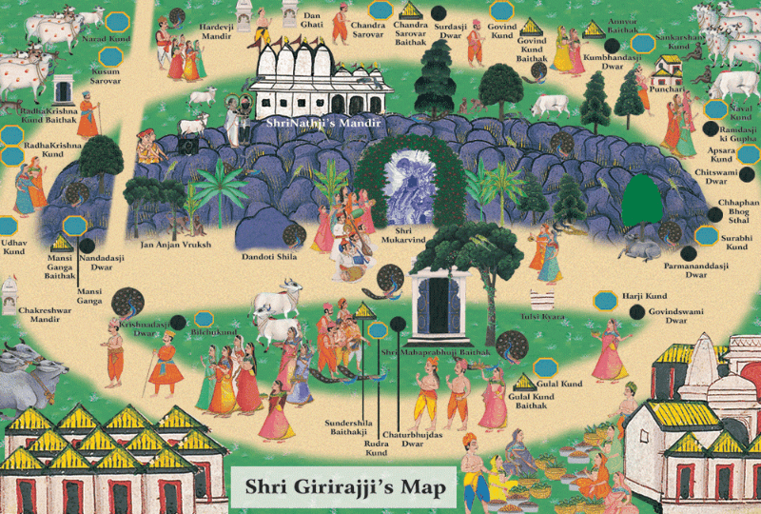

Slide 11
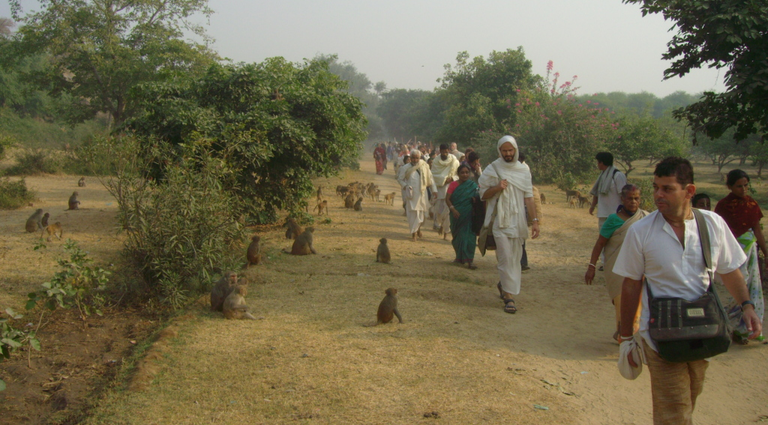
Notes:
Some devotees just walk around Govardan doing the parikrama.. - EASY

Slide 12
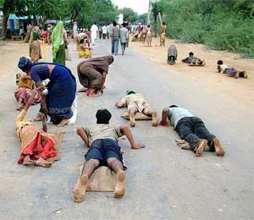
Notes:
Some devotees go around doing dandavats all the way around Govardhan.. - DIFFICULT

Slide 13
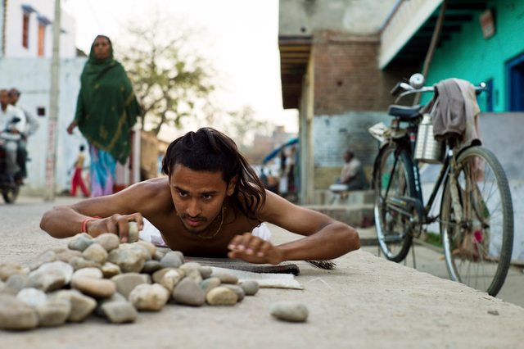
Notes:
And some doing 108 dandavats for their same body length.. – MOST DIFFICULT. Take month or months to complete.

Slide 14
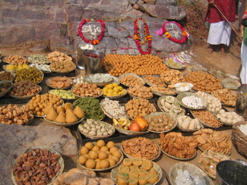
Govardhan Puja
Notes:
Hundreds of preparations are made and offered to Giri Govardhan!

Slide 15
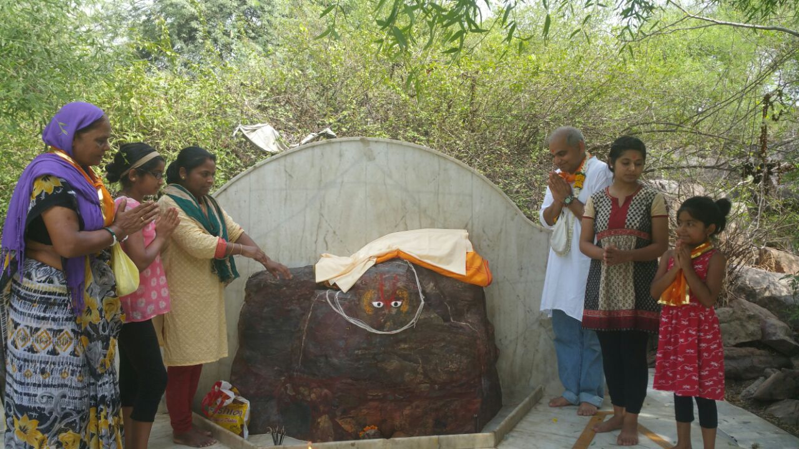
My Great Govardhan Puja...
Notes:
We were fourtunate enough to be in govardhan in purhottam month, on ekadasi, and that ekadasi was rohini ekadasi which comes once in 3 years!

Slide 16
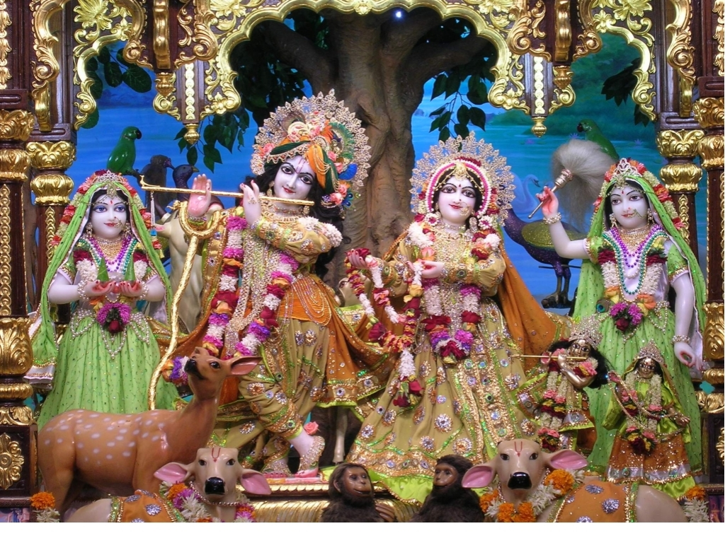
Thank You and Hare Krishna

